Slide 1

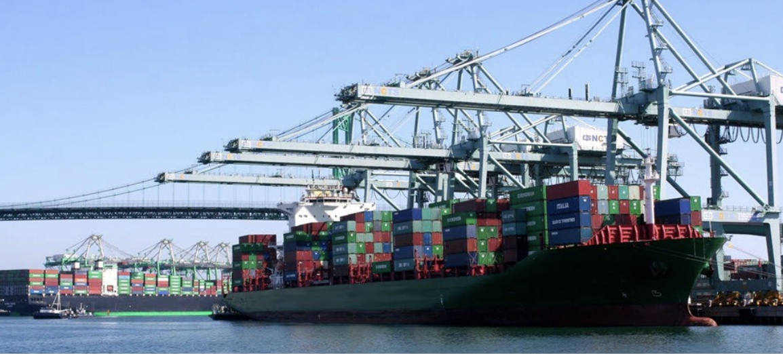
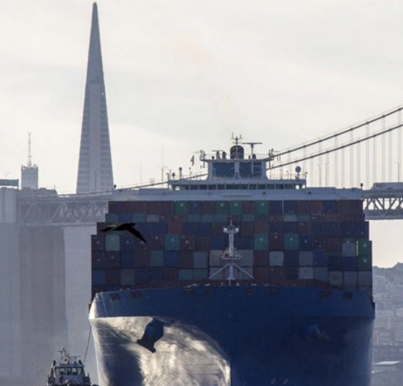
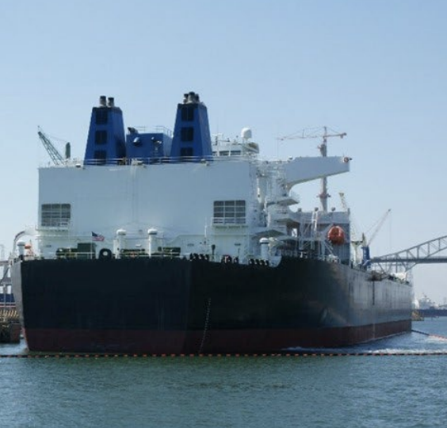
Building an Ocean-Going Vessels Emission Inventory Part of a High-Resolution Modeling Framework for Port-Related Emissions in Southern California
Yan Lu

Slide 2

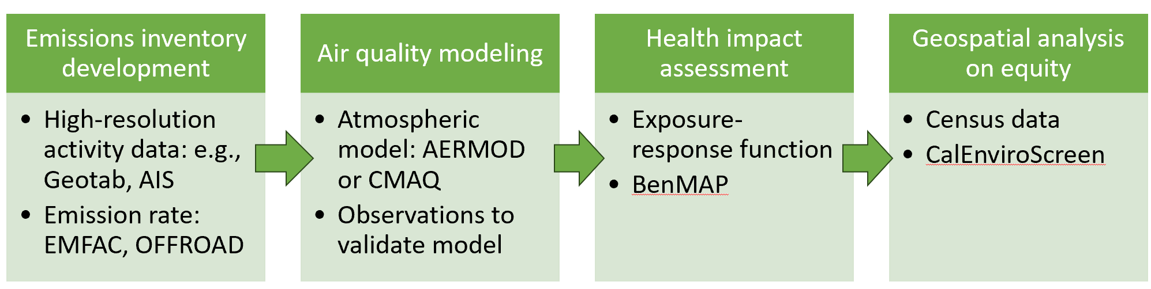
1.1 Project Overview
Aim 1: High-resolution modeling framework for evaluating the air quality, health, and equity impacts of port-related emissions
Aim 2: Environmental health disparities arising from port congestion in 2021 due to the COVID-19 pandemic and supply chain disruptions
Yan’s Focus: Developing an emission inventory for Ocean-Going Vessels near the Ports of LA and LB
Notes:
(ocean going vessels, trucks, locomotives, and cargo handling equipment)

Slide 3
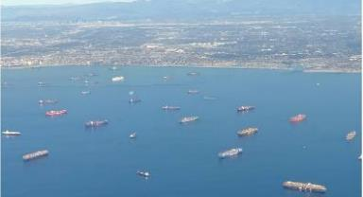
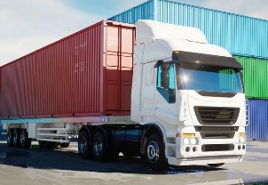
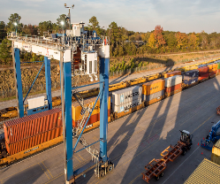
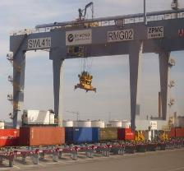
Conducted the first comprehensive assessment of NOx, PM, and CO₂ emissions due to congestion at Ports of Los Angeles/Long Beach
Shifted consumer behavior
Record-breaking import volumes
Vessel Delays
Port Congestion
Excess emissions
(near shore)
COVID-19
Supply & Demand Imbalance
Labor shortage
More Landside
Transportation
Pandemic
Ocean going vessels
Trucks
Locomotives
Cargo handling equipment
Landside transportation
Notes:
I want to share with you a piece of our recent work on the emissions from the operation of the Ports of Los Angeles and Long Beach, which is the largest gateway of the US.
Following the COVID-19 outbreak, these ports experienced a significant surge in cargo imports (recording breaking import volumes) due to shifted consumer behavior and labor shortage due to the pandemic. This imbalance of supply and demand led to severe congestion at terminals and surrounding areas.
As a result,
There was an increased number of vessels waiting for berths loitering near shore
Additionally, the increased goods movement resulted in higher emissions from the landside freight network.
These emissions negatively impacted air quality, especially in communities near the ports and freight transportation networks.
To estimate the impacts, we conducted the first comprehensive assessment of PM, NOx, and CO2 emissions during the Port Congestion Period.
Our assessment covers not only emissions from ocean going vessels, but also emissions from cargo handling equipment, locomotives, and trucks.

Slide 4
Excess emissions occurred between July 2020 – August 2022
Excess NOx emissions peaked in October 2021 at 23 tons per day
Queuing system implementation
Pacific Maritime Management Services (PacMMS) implemented a queuing system in November 2021 encouraging vessels to wait outside of the “Safety and Air Quality Area”
Number of vessels loitering or anchored near shore returned to pre-pandemic levels, despite high volume of TEUs
Vessels waiting for berth move 50-150 nm from the shore.
Notes:
We found that excess emissions occurred between July 2020 to August 2022.
This figure shows NOx emissions as an example. The bars represent excess emissions with blue color denoting excess emissions from ocean going vessels and orange color denoting excess emissions from landside freight networks.
Specifically, the at-berth, anchored, and loitering activities of container vessels generated NOx emissions of 5.1 tons per day (tpd) averaged over the port congestion period, while their BAU emissions were only 0.1 tons per day. Peak excess NOx emissions of 23.2 tons per day occurred in October 2021.
The reason is that - on November 16, 2021, Pacific Maritime Management Services (PacMMS) implemented a queuing system to encourage vessels to wait for a berthing assignment outside of the “Safety and Air Quality Area”, which is 50 or 150 nautical miles off the shore of California. The queuing system calls for vessels to voluntarily drift beyond 50-150 nm offshore when they do not have a berthing assignment within 72 hours. After the implementation of the queueing system in November 2021, loitering of container vessels dissipated and the number of vessels at anchorages and loitering trended toward pre-pandemic levels.
Another key objective of this study is to identify strategies to manage unexpected surges in cargo throughput more effectively.
We
DISCARD:
To put this number of excess NOx emissions into perspective, total NOx emissions from all sources (including stationary, area, and mobile sources) in the South Coast Air Basin (SCAB) were estimated to be 350 tpd in 2018. The carrying capacity of NOx is 60 tpd in 2037, which means that NOx emissions need to be controlled under 60 tpd to attain the federal 70 parts per billion (ppb) 8-hour ozone standard (South Coast Air Quality Management District, 2022). Therefore, repeated future occurrences of port congestion events could jeopardize attainment of federal ozone standard standards.

Slide 5
Clean transportation regulations could significantly reduce emissions
NOx
PM
CO₂
87% reduction
84% reduction
81% reduction
The CLEAN scenario, a hypothetical scenario in 2035, assuming similar level of port congestion as the ACTUAL scenario, but with the implementation of clean transportation policies.
Trucks: Heavy-Duty Inspection and Maintenance, Heavy-Duty Omnibus, Advanced Clean Trucks, and Advanced Clean Fleets
Locomotives: In-Use Locomotive Regulation
Notes:
We also conducted an additional scenario assessment to quantify the potential reductions in excess emissions from land-based freight transport due to more stringent emission reduction regulations over the years.
We estimated the excess emissions for a hypothetical CLEAN scenario, assuming the same proportional increase in cargo throughput as CONGESTION, but with the full implementation of adopted CARB regulations and projected baseline activity growth in 2035.
The take away point is that if the excess emissions in 2035 if a similar port congestion event happens would be much lower than 2022 due to the adopted clean transportation regulations in California.
Discard:
In-use locomotives regulation: operators will now be required to pay into a spending account, and the amount will be determined by the emissions they create while operating in California. Companies will be able to use the funds to upgrade to cleaner locomotive technologies. Locomotives also will have a 30-minute idling limit. Additionally, switch, industrial and passenger locomotives built in 2030 or after will be required to operate in zero-emissions configurations while in California, and in 2035 for freight line haul.

Slide 6
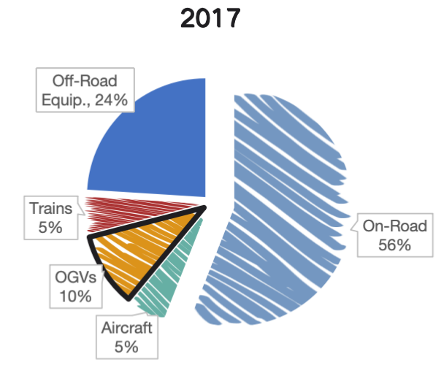
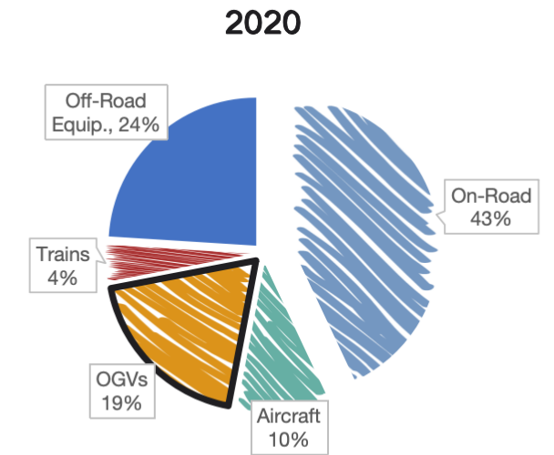
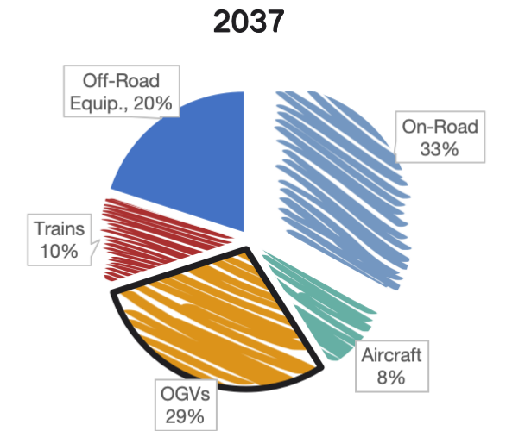
1.2 Ocean-Going Vessels (OGVs) Emissions
OGVs are a significant source of NOx, PM, and VOC emissions (California Air Resources Board, 2021)
Key contribution to port-related air pollution. (U.S. EPA, 2009)
Fig.1 OGV NOx Emission Contribution in Southern California by Sector by sector in 2017, 2020 and 2037
California Air Resources Board. (2021). 2022 Strategy for the State Implementation Plan Draft Measures. Retrieved from https://ww2.arb.ca.gov/sites/default/files/2021-10/2022_SSS_Draft_Measures.pdf
U.S. Environmental Protection Agency. (2009). Current Methodologies in Preparing Mobile Source Port-Related Emission Inventories. Retrieved from https://archive.epa.gov/sectors/web/pdf/ports-emission-inv-april09.pdf

Slide 7
2.1 Methods of calculating vessel emissions
Bottom-up method
Top-down method
Fuel-based (FB) method
Less used
Data Collection
Total Emission Data
Vessel activity data (speeds, and operational hours)
Engine Data (Characteristics include engine power, type, max speed)
Using fuel consumption statistics and proxies such as vessel activity data
spatial surrogate
Emissions Calculation
Disaggregate
P : Engine operating power (kW), calculated using propeller law.
A : Engine operating hours (hours)
EF : Emission factors (g/kWh)
LLAF : Low load adjustment factor
E=P×A×EF×LLAF

Slide 8
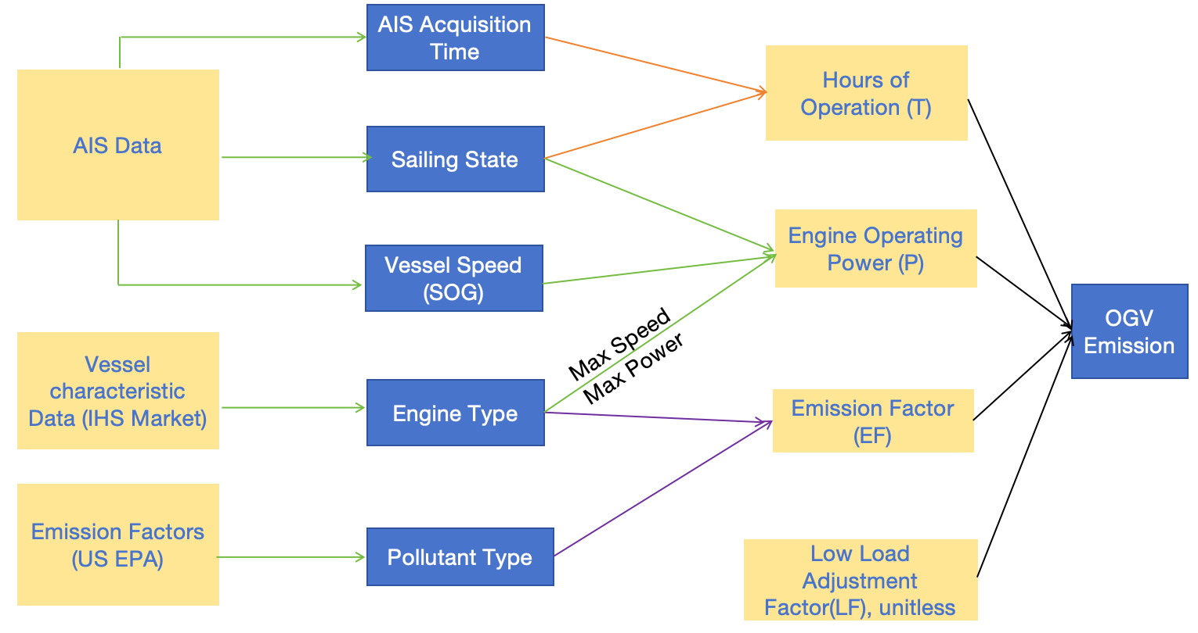
2.2 Our method of calculating vessel emissions
Emissions (g)=(Engine Operating Power (kW))×(Hours of Operation)×(Emission Factor (g/kWh))

Slide 9
2.3 Data Sources
Vessel Activity
Engine Defults & Characteristics
Emission Factors
01/2020 – 06/2022
AIS Records
01/2020 – 06/2022
IHS Records
CARB
US EPA
Challenges Here!!!!

Slide 10
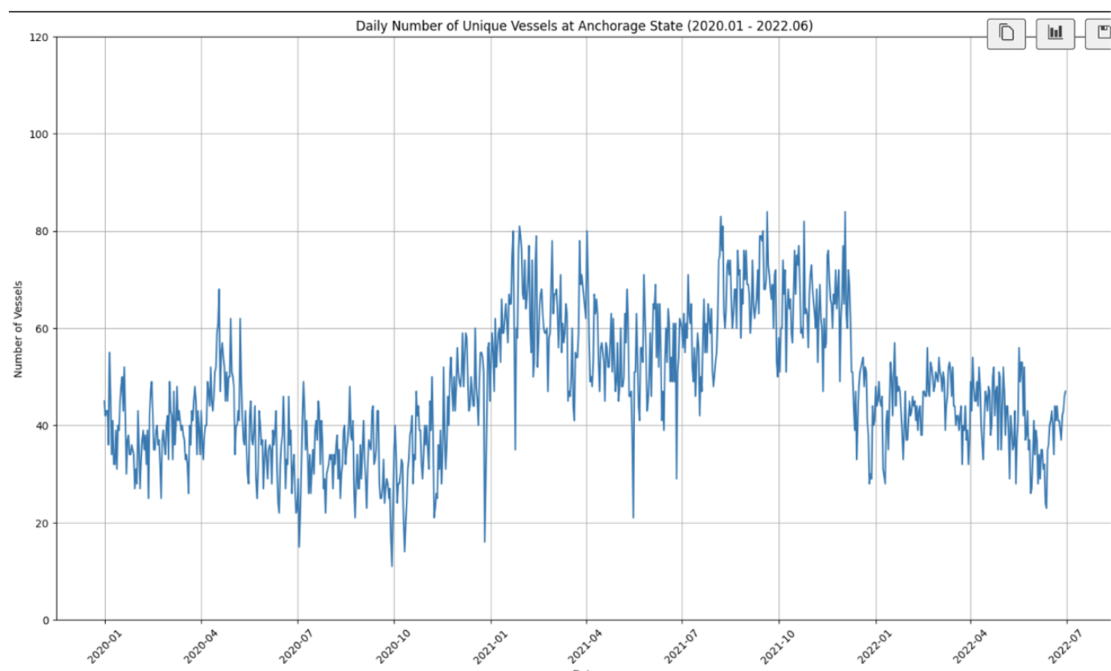
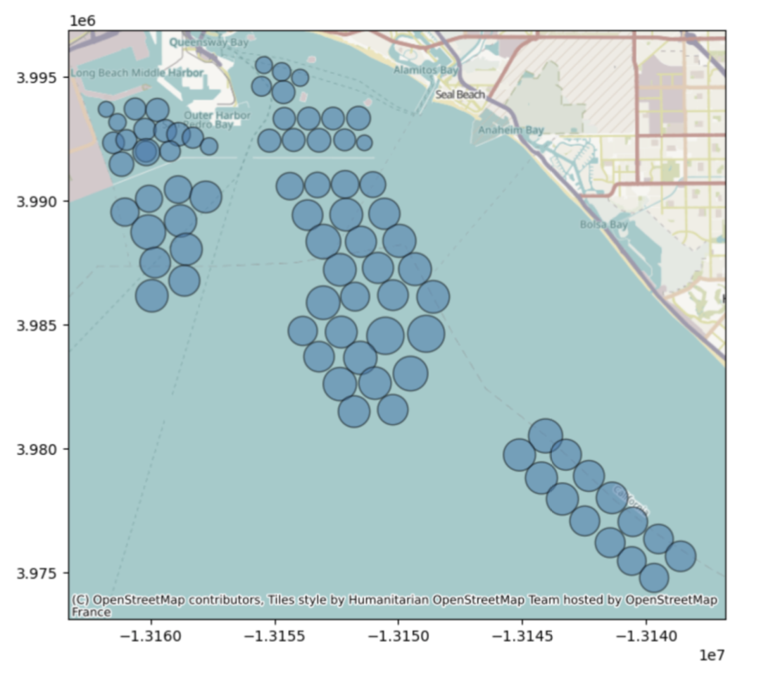
3.1 Preliminary results
Daily Number of Unique Vessels at Anchorage
Anchorage zones

Slide 11
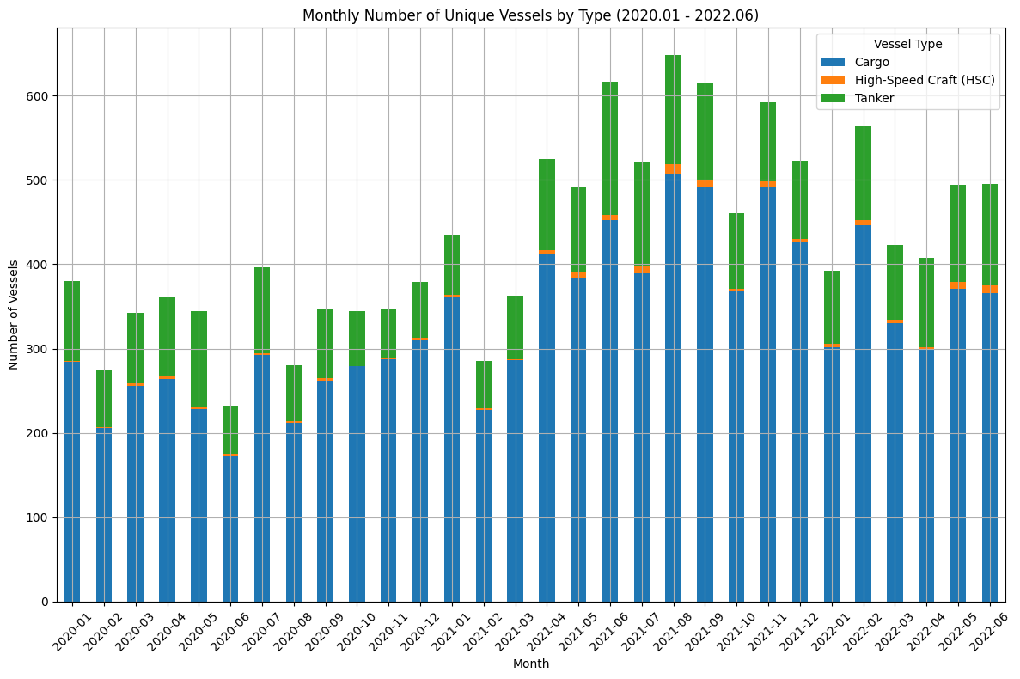
3.2 Preliminary results
Unique Vessels by Type

Slide 12
4 Challenges, Future Steps, and Opportunities
Negotiating data pricing with IHS
Processing large datasets for spatial and temporal analysis to create emissions inventories at a 1 km x 1 km or even 50 m x 50 m resolution
Will perform AERMOD or CMAQ simulations
What types of analyses would be beneficial for your work?

Slide 13



